Slide 1



KPMG VIRTUAL INTERNSHIP
Data analytics approach
-By Rishabh Kumar Yadav

Slide 2
Agenda
Introduction
Data Exploration
Model Development
Interpretation

Slide 3
Introduction
Sprocket Central: Sprocket Central is a renowned company that specializes in providing high-quality bikes and cycling accessories.
Objective: The primary objective of this analysis is to identify and recommend the customers that Sprocket Central should target in order to achieve higher value for the company. By focusing on the right customer segments, Sprocket Central aims to maximize its revenue and strengthen its market position.
Expected Outcomes: Through this analysis, the marketing team expects to uncover valuable patterns and trends within the data. By understanding customer preferences, purchasing behavior, and potential opportunities, Sprocket Central can tailor its marketing efforts to attract and retain high-value customers.

Slide 4
Data Exploration
Data Quality Assessment and Clean Up
Key Issues for Data Quality Assessment
Accuracy: correct values
Completeness: Data fields with values
Consistency: Values free from Contradiction
Currency: Values up to date
Relevancy: Data items with value Meta-data
Validity: Data Containing Allowable Values
Uniqueness: Records that are Duplicated
 | Accuracy | Completeness | Consistency | Relevancy | Validity
Transaction | Profit: Missing | Online Order: Few blank rows Brand: Few blank rows |  |  | Transection Date: Format List Price: Format Standard Cost: Format Product first sold date: Format
Customer Demographic | DOB: Inaccurate with few blank rows Age: Missing | Job Title: Few blank rows | Gender: Inconsistency like F, U, Femal, M | Job Industry Category: Few rows with Irrelevant data(N/A) Default Column: Irrelevant data
Customer Address |  | Job Title: Few blank rows | State: Inconsistency | Job Industry Category: Few rows with Irrelevant data (N/A) | Post Code: Format Property Valuation: Format Value: Format

Slide 5
Data Exploration
Customer by Gender
Female customers account for 52% of the customer base, while male customers make up the remaining 48%. This suggests a relatively balanced gender representation among customers.
Customer by Gender
In 2017, female customers placed a total of 9,969 orders, while male customers placed 9,476 orders.

Slide 6
Data Exploration
Customer by Age Group
Most of the order was done by the age group of 41 to 50. This group represents a valuable market segment and should be a focal point for marketing and sales strategies.
Customers aged between 21 and 70 constitute a significant portion of the customer base, with approximately 600 to 700 individuals falling within this age range.
Order based on different Age Group
Most of the order was done by the age group of 41 to 50 stands out as the primary contributor to the majority of orders placed.
There is a scarcity of orders from customers above the age of 71, suggesting a lower level of engagement in the purchasing process.

Slide 7
Data Exploration
Customer by Wealth Segment
The majority of customers, accounting for 50%, belong to the Mass Customer category.
Affluent customers make up 25% of the segment, while the remaining 25% comprises high net worth customers.
Order by Wealth Segment
The Mass Customers placed the highest order of 9750.
Affluent and high net worth customers ordered between 4700 and 5000.
A significant presence of Mass Customers and highlight their potential for generating higher order values compared to the other segments.

Slide 8
Data Exploration
Order by job industry
Order data from 2017 reveals that the Financial Services, Health, Manufacturing, and other job industries were responsible for a significant number of orders, ranging from 3000 to 4000.
Past 3yr order history by job industry
The past 3 years purchase order data, it was observed that these four industries, namely Financial Services, Health, Manufacturing, and others, consistently dominated the order activity.
This indicates their continued reliance on procurement and highlights their significance in the overall purchasing landscape.

Slide 9
Data Exploration
Order by Brand
Solex brand is highly preferred by customers, with a height order of 4169, indicating its popularity.
Following closely are WearA2B and Giant Bicycles, with a second height order around 3245.
Average profit by Brand
WearA2B brand achieved the highest average profit, while the Solex brand ranked third in terms of average profit.
Solex and WearA2B are key players in the market, with significant customer preference and profitability.

Slide 10
Data Exploration
Customer by State
The customer base in Australia is primarily concentrated in New South Wales (NSW), with approximately 53% of the customer base.
Victoria (VIC) has the second largest customer base, comprising 26% of the total, while Queensland (QLD) represents the remaining 21%.
Order by State
The majority of orders received were from NSW, with a total of 10,307 orders.
NSW dominates both the customer base and order volume, suggesting it is a crucial market for business growth.

Slide 11
Data Exploration
Customer how owns car
The customer base is evenly split, with a 50:50 ratio between car owners and non-car owners.
Order by car owner
There is a marginal difference in the number of orders received from these two groups. Car owners placed 9,819 orders, while non-car owners placed 9,626 order.
Indicating that car ownership does not significantly impact the order volume. whether a customer owns a car or not does not affect their likelihood of placing an order.

Slide 12
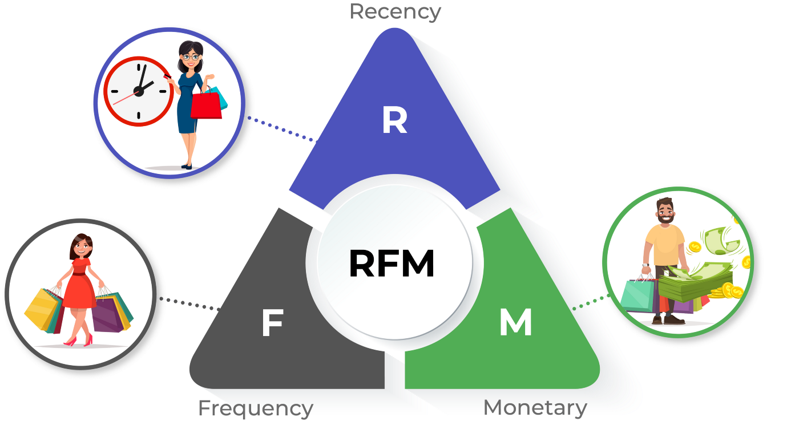
Data Modeling
RFM Analysis
The RFM model, which stands for recency, frequency, and monetary analysis, offers an ideal approach for businesses seeking to identify their most valuable customers. By quantitatively examining three key factors - the customer's recency of purchase, frequency of purchases, and monetary contribution - businesses can determine the best customers to target for revenue growth and increased overall value.

Slide 13
Data Modeling
Customer Segment and RFM Score
Customers with a very loyal and platinum status exhibit high RFM (Recency, Frequency, Monetary) scores above 400, indicating their strong engagement and consistent purchasing patterns.
Lost customers, evasive customers, and almost lost customers possess low RFM scores ranging from 111 to 133, suggesting decreased activity and potential disengagement.
Customer Segment | Segmentation Criteria
Very Loyal | Very low recency, low frequency, but high amount spent
Lost Customer | Very Low RFM
Very Loyal | Most recent, buys often, spends large amount of money
Losing Customer | Purchase was a while ago, below average RFM value
Potential Customer | Bought recently, never bought before, spent small amount
Customer Title | Description
High Risk Customer | Purchase was long time ago, freuency is quite high, amount spent is high
Recent Customer | Bought recently, not very often, average money spent
Late bloomer | No purchases recently, but RFM value is larger than average Purchases was a while ago, below average RFM value
Evasive Customer | Very low recency. Very low frequency, small amount spent Very Low RFM
Platinum Customer | Most recent buy, buys often, most spent
Becoming Loyal | Relatively recent, bought more than once, spends large amount of money

Slide 14
Data Modeling
Recency VS Monetary
The analysis of the chart reveals that customers who made purchases more recently have contributed significantly higher revenue compared to those who visited the store a while ago.
Customers from the recent past (within 50-100 days) have also generated a moderate amount of revenue.
Customers who visited more than 200 days ago have shown a lower contribution to overall revenue.
This suggests that maintaining customer engagement and encouraging repeat visits are crucial for maximizing revenue generation.

Slide 15
Data Modeling
Recency VS Frequency
It was observed that there is a very low frequency of 0-2, which is correlated with high recency values, specifically more than 250 days ago.
Customers who have visited more recently (0-50 days) have a higher likelihood of visiting more frequently, 10 or more times.
A higher frequency is negatively correlated with recency values. This means that very recent customers tend to be frequent visitors, indicating a strong relationship between recency and frequency.

Slide 16
Data Modeling
Customer Segment and RFM Score
Customers classified as "Platinum Customer," "Very Loyal," and "Becoming Loyal" visit the business frequently. This correlation between customer loyalty and visit frequency has a direct impact on increased revenue for the business.
It is evident that the more often these loyal customers visit, the higher the monetary gain for the business.
This positive relationship between visit frequency and revenue highlights the importance of nurturing customer loyalty and recognizing the value of these loyal customers.

Slide 17
Data Modeling
Customer Distribution by Customer Segment
Customers classified as "Platinum Customer," "Very Loyal," and "Becoming Loyal" visit the business frequently. This correlation between customer loyalty and visit frequency has a direct impact on increased revenue for the business.
It is evident that the more often these loyal customers visit, the higher the monetary gain for the business.
This positive relationship between visit frequency and revenue highlights the importance of nurturing customer loyalty and recognizing the value of these loyal customers.

Slide 18
Data Interpretation
Old Customer Target and Methodology
Rank | Customer Segmentation | Segmentation Criteria | No. of Customer | Cumulative | Customer Selection
1 | Platinum Customer | Most recent buy, buys often, most spent | 165 | 165 | 165
2 | Very Loyal | Most recent, buys often, spends large amount of money | 319 | 484 | 319
3 | Becoming Loyal | Relatively recent, bought more than once, spends large amount of money | 217 | 701 | 217
4 | Recent Customer | Bought recently, not very often, average money spent | 371 | 1072 | 299
The top 1000 customers should be filtered based on specific conditions. These conditions, as discussed in the table, would include customers who have made recent purchases, have a history of frequent purchases, and tend to spend more compared to other customers. By applying these criteria, a group of 1000 customers can be identified for further analysis, allowing for insights into their buying patterns and potential opportunities for business growth.

Slide 19
Data Interpretation for New Customer
Top 25 New Valuable Customer
Marketing team should deploy the targeted model based on the above analysis reveals key insights about the target customers.
The customer segment falls within the age range of 41 to 50, indicating a specific demographic to focus on.
The Mass Consumer Segment is the primary audience, suggesting a large customer base.
The financial services and manufacturing industries are the main sectors connected to these customers, providing opportunities for tailored marketing.
Solex brand and Standard product are highly valued by this customer group.
The majority of these customers reside in New South Wales, enabling geographically targeted campaigns.

Slide 20
Note: The data and information in this document is reflective of a hypothetical situation and client. This document is to be used for KPMG Virtual Internship purposes only.
Appendix

